Slide 1
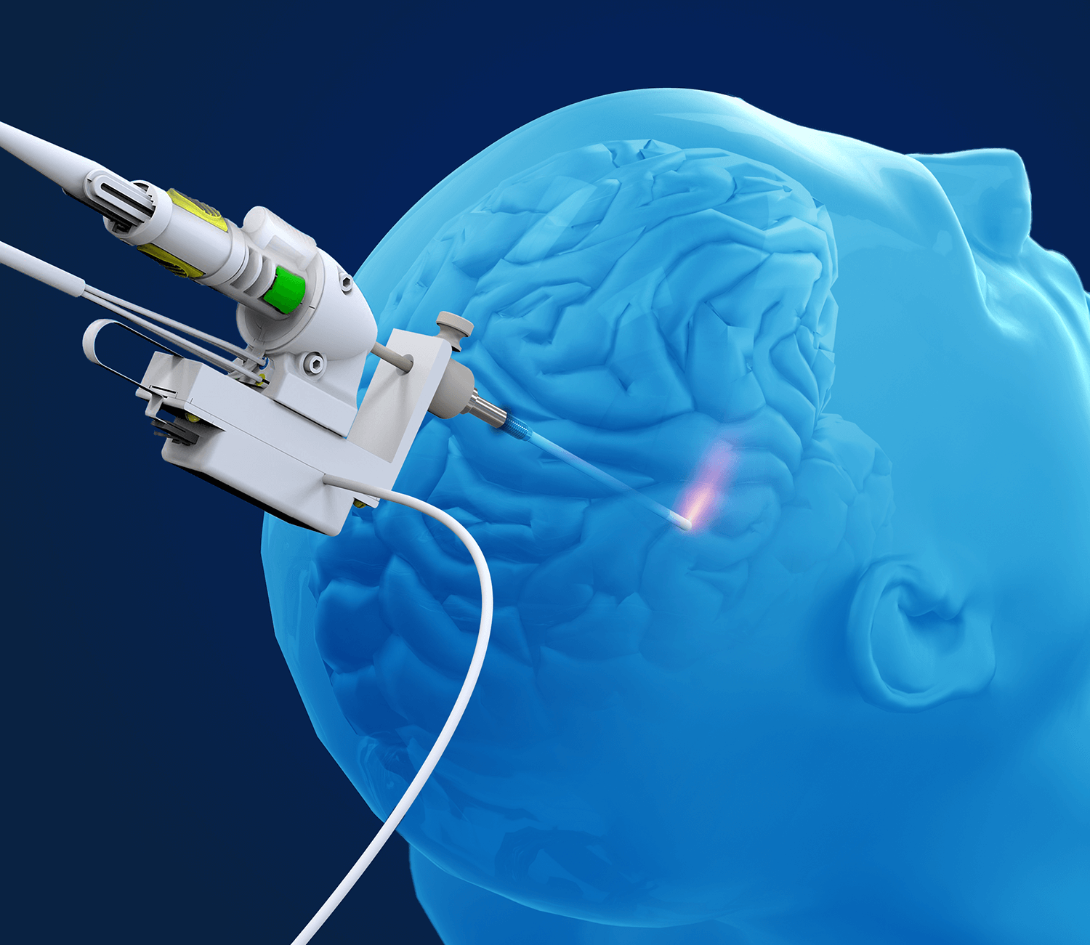
Brain Tumor Ablation
Simplified Path Planning for application in brain surgery
Thomas Birney and Nicholas Novak

Slide 2
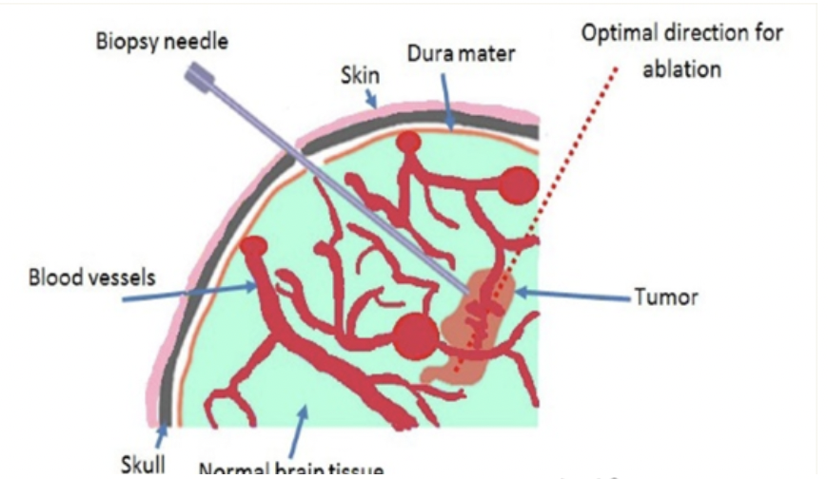
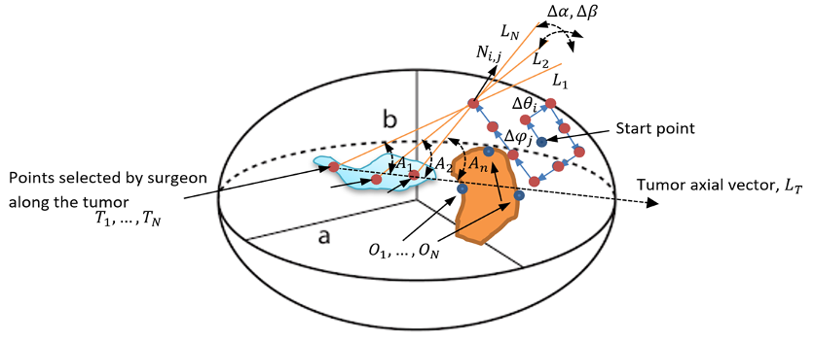
Brain Surgery: Background
Requires brain scan
MRI
Requires path planning
Paths build prior to surgery by neurosurgeon
An extra day needed for planning
Requires separate operating theatre
Sterile operating environment for tumor removal

Slide 3
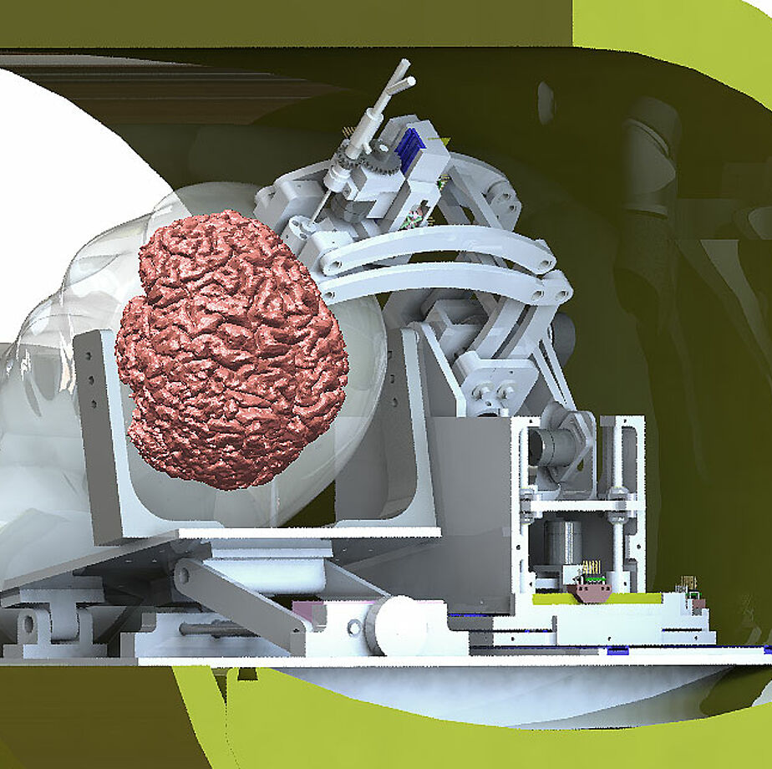
MRI-safe robots: A potential solution
To cut down on time, MRI-safe robots can be used
Operate in the MRI environment
Simultaneous with the scan
Minimally invasive
Need a planning algorithm to work in tandem with MRI scan
Modified RRT can be used where RRT and action-based planning are implemented

Slide 4
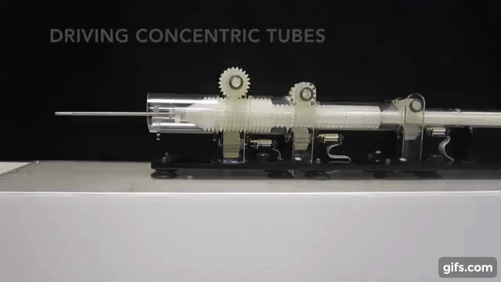
Hardware: New Syringe Robot
New developments have designed a concentric needle robot
Curving needle
Allows many different paths
If built out of aluminum, can be used with MRI
Provides basis for pathfinding

Slide 5
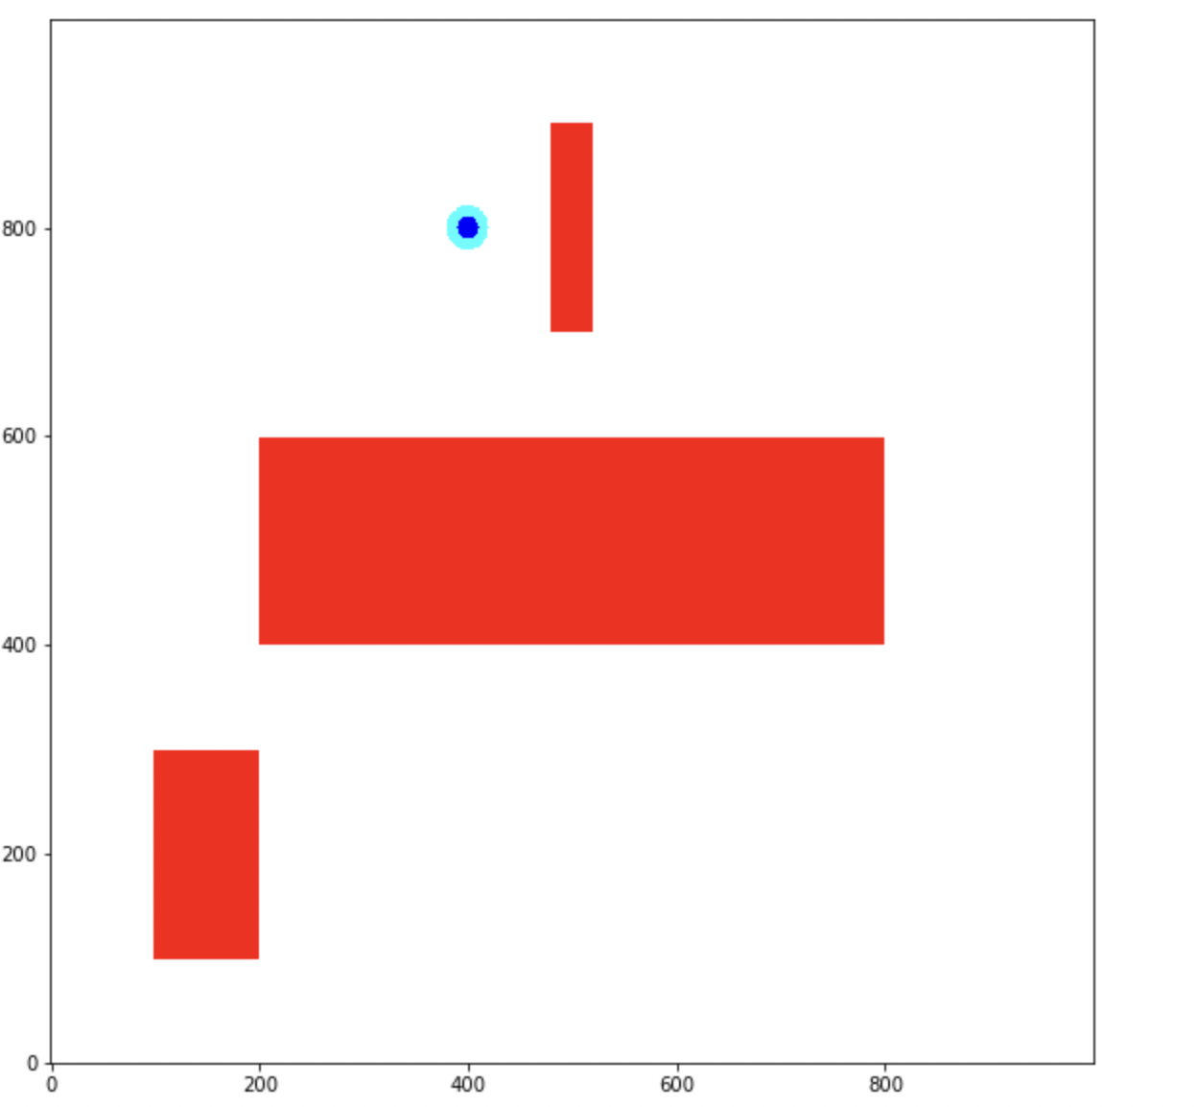
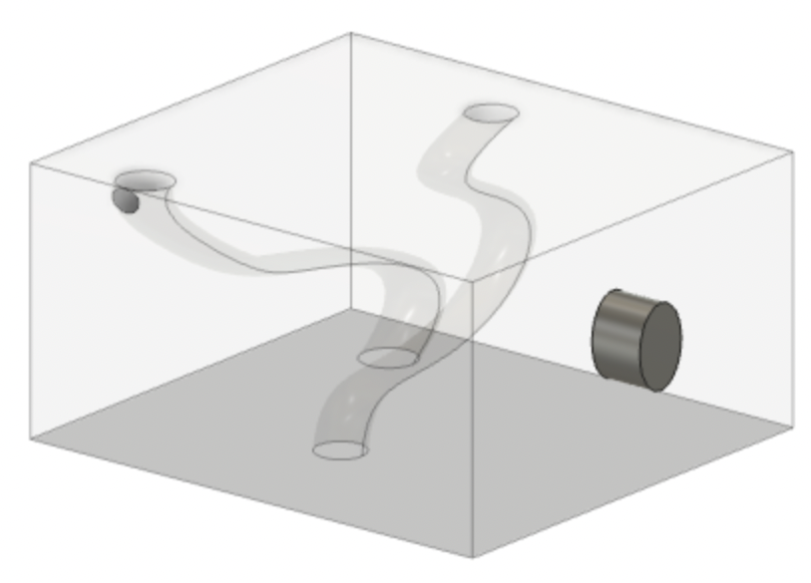
Approach: 2D
For simplicity of calculations, a 2D approach will be used
Can be adapted into 3D
Three needles will be implemented
The first one is straight
The following two are curved

Slide 6
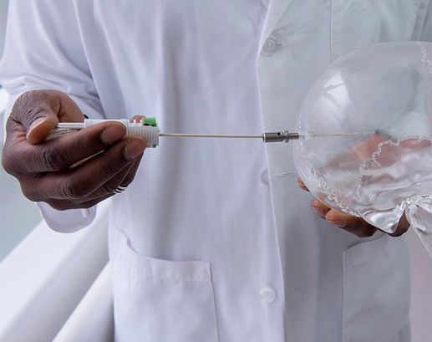
Approach: First syringe
The first syringe is straight
RRT can be used to sample potential starting configurations
Also can check if the goal is reachable with a single needle
Traditional ablation methods usable

Slide 7
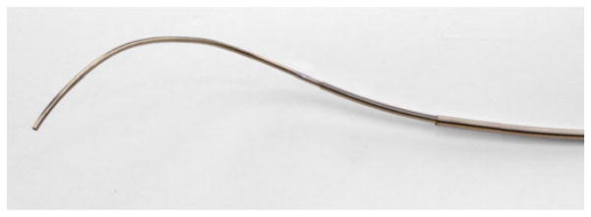
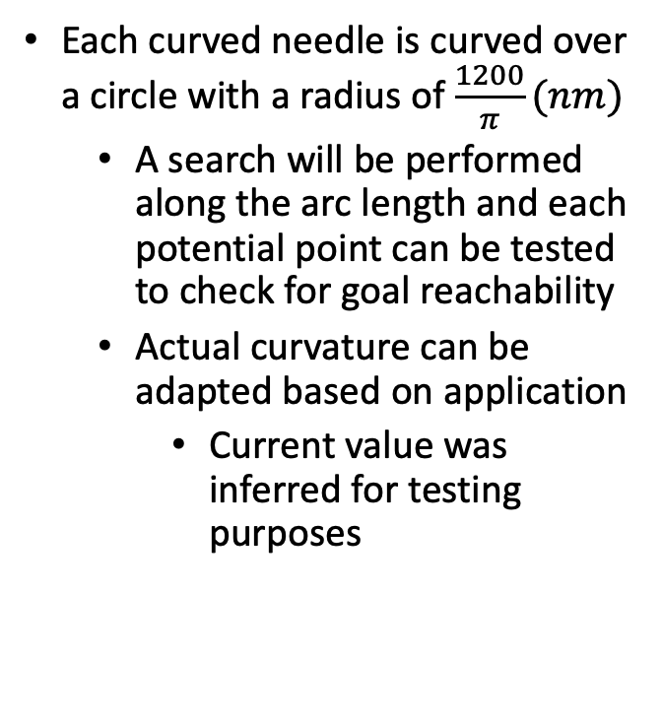
Approach: Curved needle
Each curved needle is curved over a circle with a radius of $\frac{1200}{π}(nm)$
A search will be performed along the arc length and each potential point can be tested to check for goal reachability
Actual curvature can be adapted based on application
Current value was inferred for testing purposes

Slide 8
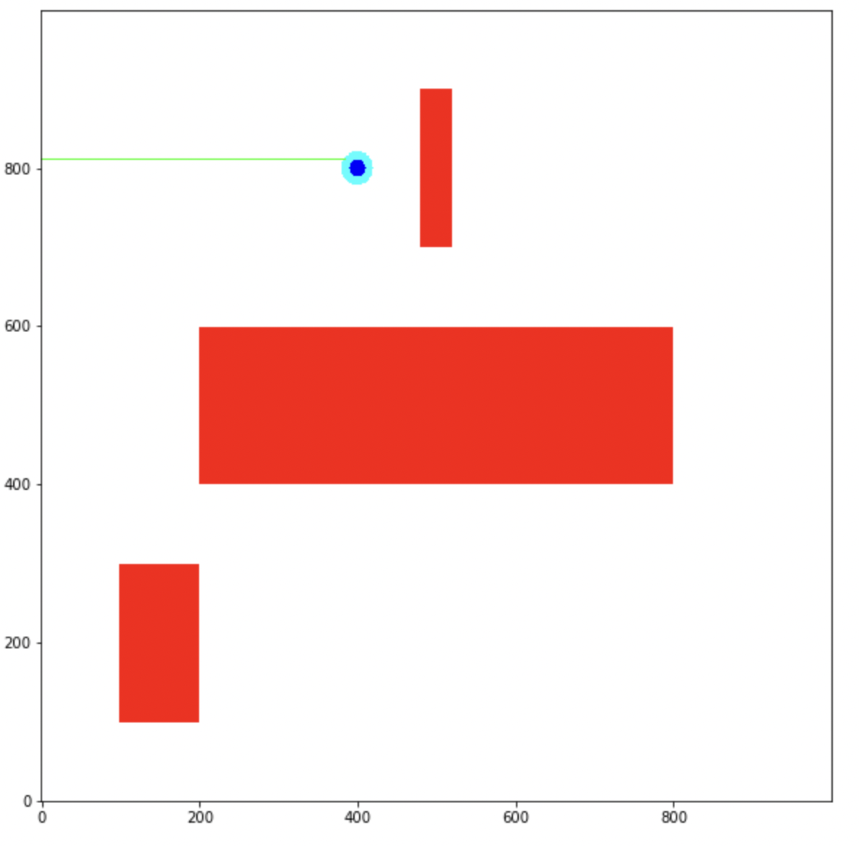
Results: 2D search: Single move goal
One needle needed to reach goal
Useful for if a surgery only needs a traditional needle

Slide 9
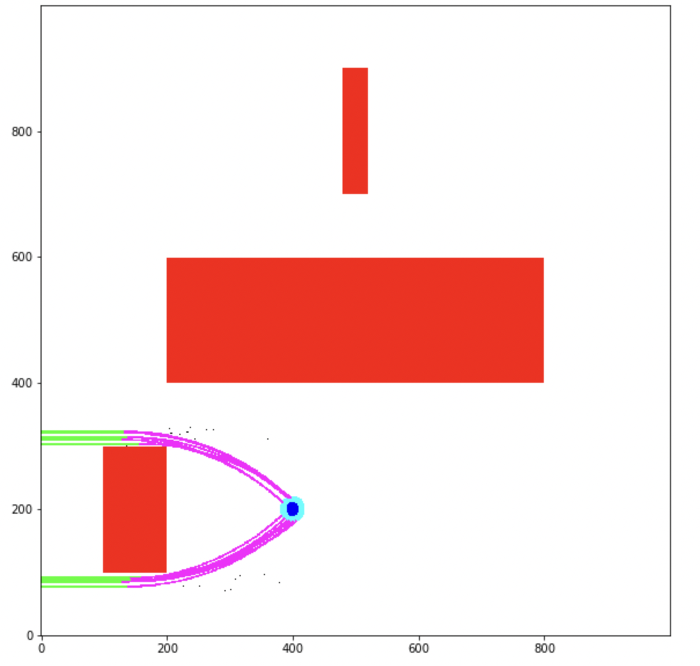
Results: 2D search: Two-move goal
Allows minimal needles to curve
Instead of two curved needles, only one is needed

Slide 10
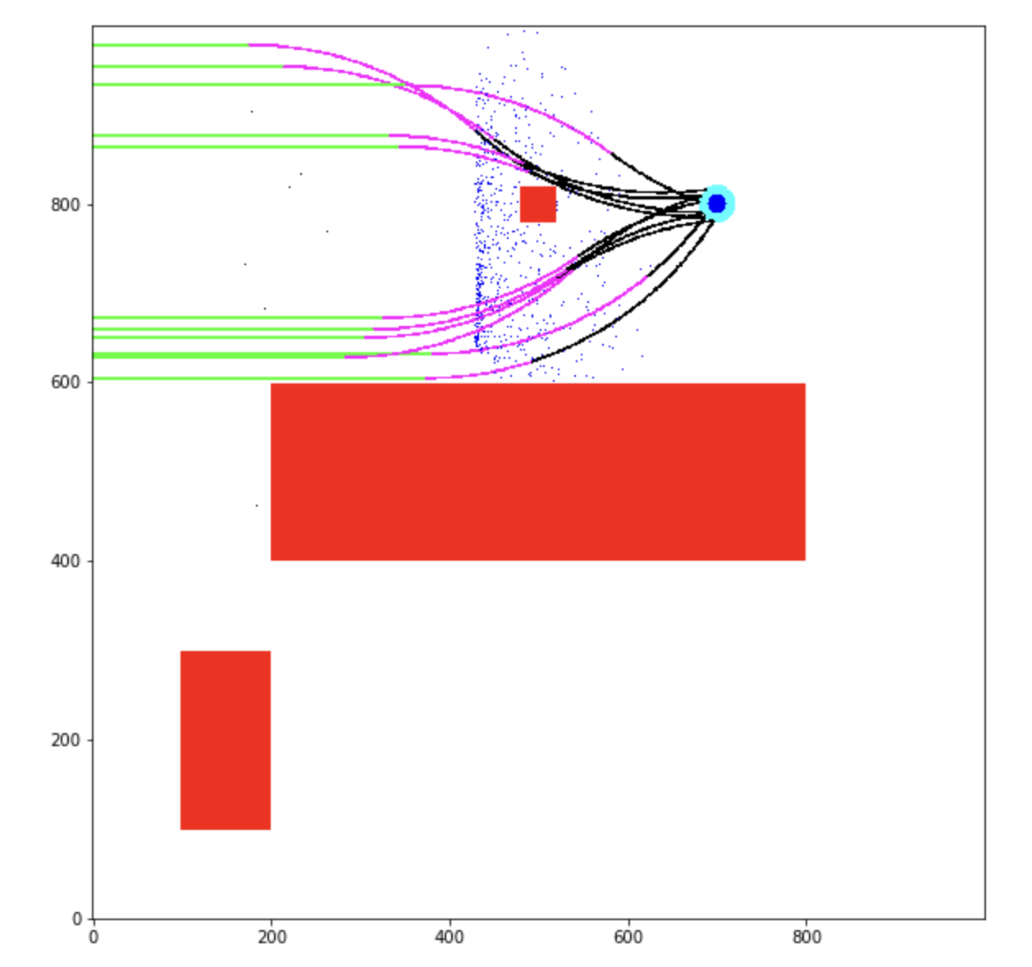
Results: 2D search: Full-Move Goal
Two needles needed
Successful goal contact

Slide 11
Results: No Solution Found
as

Slide 12
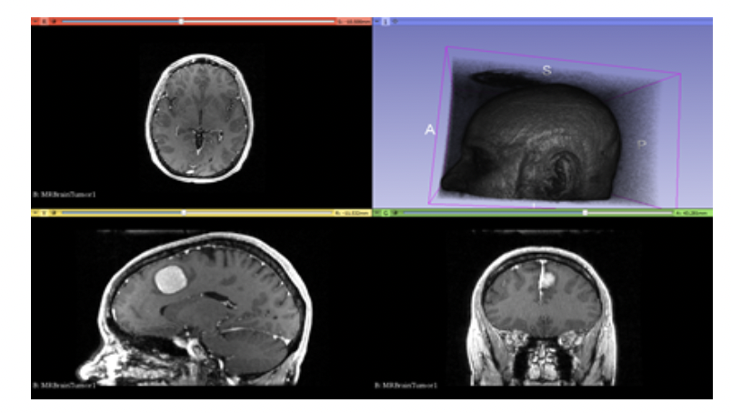
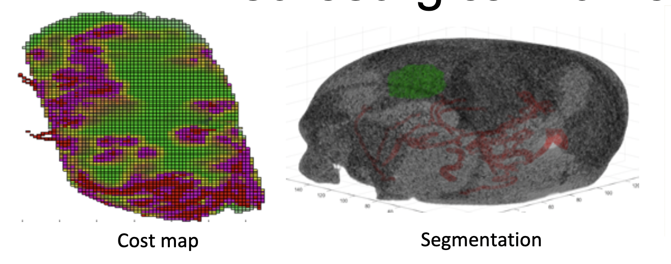
Future Work
Future work on this project will include:
Moving the workspace into a rectangular prism
Adapting workspace into a cranium shape
Interpreting MRI data to create an obstacle map
Developing a transition from the 2D to 3D search

Slide 13
Publication References

Slide 14
Image References
https://www.monteris.com/wp-content/uploads/2019/02/nb-man-home-v101.png
https://www.faulhaber.com/fileadmin/_processed_/5/a/csm_wa2_MRI-Robot_Quanser_e494be2dc9.jpg
https://consultqd.clevelandclinic.org/wp-content/uploads/sites/2/2017/06/17-NEU-793-Onwuzulike-650x450.jpg

